Slide 1
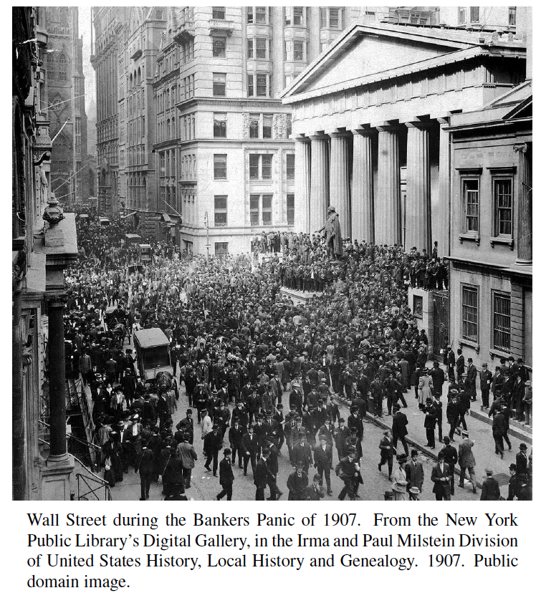
Priority Queues
Presentation for use with the textbook Algorithm Design and Applications, by M. T. Goodrich and R. Tamassia, Wiley, 2015

Slide 2
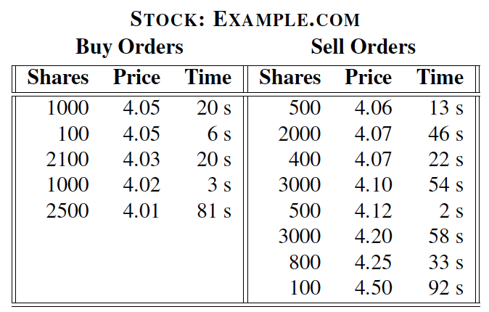
Application: Stock Matching Engines
At the heart of modern stock trading systems are highly reliable systems known as matching engines, which match the stock trades of buyers and sellers.
A simplification of how such a system works is in terms of a continuous limit order book, where buyers post bids to buy a number of shares in a given stock at or below a specified price and sellers post offers to sell a number of shares of a given stock at or above a specified price.

Slide 3
Application: Stock Matching Engines
Buy and sell orders are organized according to a price-time priority:
“price” has highest priority and if there are multiple orders for the same price, then ones that have been in the order book the longest have higher priority.
When a new order is entered, the matching engine determines if a trade can be immediately executed and if so, then it performs the appropriate matches according to price-time priority.
This amount to two instances of the data structure we discuss here—the priority queue—one for buy orders and one for sell orders.
This data structure performs element removals based on priorities assigned to elements when they are inserted.
Sell orders
Matching
Engine
Buy orders

Slide 4
Total Order Relations
Keys in a priority queue can be arbitrary objects on which an order is defined
Every pair of such keys must be comparable according to a total order.
Mathematical concept of total order relation ≤
Comparability property: either x ≤ y or y ≤ x
Reflexive property: x ≤ x
Antisymmetric property: x ≤ y and y ≤ x ⇒ x = y
Transitive property: x ≤ y and y ≤ z ⇒ x ≤ z

Slide 5
Priority Queue Operations
A priority queue stores a collection of entries
Each entry is a pair (key, value)
Main methods:
insert(k, v) inserts an entry with key k and value v
removeMin() removes and returns the entry with smallest key, or null if the the priority queue is empty
Additional methods:
min() returns, but does not remove, an entry with smallest key, or null if the the priority queue is empty
size(), isEmpty()
Applications:
Standby flyers
Auctions
Stock markets

Slide 6
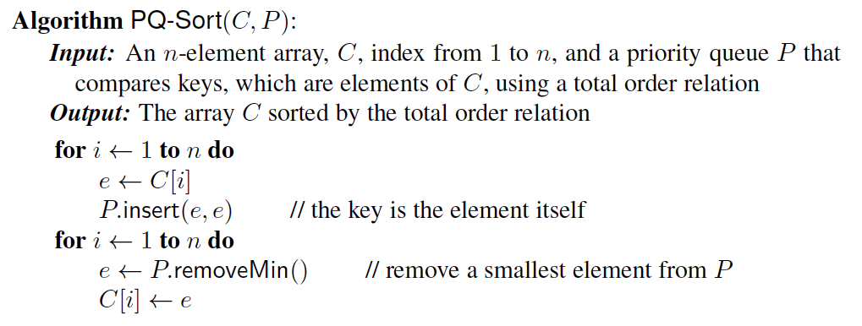
Priority Queue Sorting
We can use a priority queue to sort a list of comparable elements
Insert the elements one by one with a series of insert operations
Remove the elements in sorted order with a series of removeMin operations
The running time of this sorting method depends on the priority queue implementation.

Slide 7
Selection-Sort
Selection-sort is the variation of PQ-sort where the priority queue is implemented with an unsorted sequence
Running time of Selection-sort:
Inserting the elements into the priority queue with n insert operations takes O(n) time
Removing the elements in sorted order from the priority queue with n removeMin operations takes time proportional to 1 + 2 + …+ n
Selection-sort runs in O(n²) time

Slide 8
Selection-Sort Example
Sequence S Priority Queue P
Input: (7,4,8,2,5,3,9) ()
Phase 1
(a) (4,8,2,5,3,9) (7)
(b) (8,2,5,3,9) (7,4)
.. .. ..
(g) () (7,4,8,2,5,3,9)
Phase 2
(a) (2) (7,4,8,5,3,9)
(b) (2,3) (7,4,8,5,9)
(c) (2,3,4) (7,8,5,9)
(d) (2,3,4,5) (7,8,9)
(e) (2,3,4,5,7) (8,9)
(f) (2,3,4,5,7,8) (9)
(g) (2,3,4,5,7,8,9) ()

Slide 9
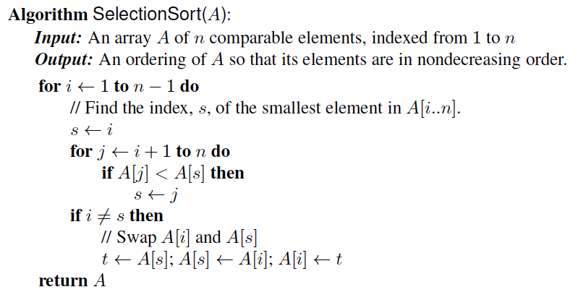
In-place Selection Sort
A sorting algorithm is in-place if it uses only a small amount of memory in addition to the input array itself.

Slide 10
Insertion-Sort
Insertion-sort is the variation of PQ-sort where the priority queue is implemented with a sorted sequence
Running time of Insertion-sort:
Inserting the elements into the priority queue with n insert operations takes time proportional to
1 + 2 + …+ n
Removing the elements in sorted order from the priority queue with a series of n removeMin operations takes O(n) time
Insertion-sort runs in O(n²) time in the worst case.

Slide 11
Insertion-Sort Example
Sequence S Priority queue P
Input: (7,4,8,2,5,3,9) ()
Phase 1
(a) (4,8,2,5,3,9) (7)
(b) (8,2,5,3,9) (4,7)
(c) (2,5,3,9) (4,7,8)
(d) (5,3,9) (2,4,7,8)
(e) (3,9) (2,4,5,7,8)
(f) (9) (2,3,4,5,7,8)
(g) () (2,3,4,5,7,8,9)
Phase 2
(a) (2) (3,4,5,7,8,9)
(b) (2,3) (4,5,7,8,9)
.. .. ..
(g) (2,3,4,5,7,8,9) ()

Slide 12
In-place Insertion-Sort
Instead of using an external data structure, we can implement selection-sort and insertion-sort in-place
A portion of the input sequence itself serves as the priority queue
For in-place insertion-sort
We keep sorted the initial portion of the sequence
We can use swaps instead of modifying the sequence
5
4
2
3
1
5
4
2
3
1
4
5
2
3
1
2
4
5
3
1
2
3
4
5
1
1
2
3
4
5
1
2
3
4
5

Slide 13
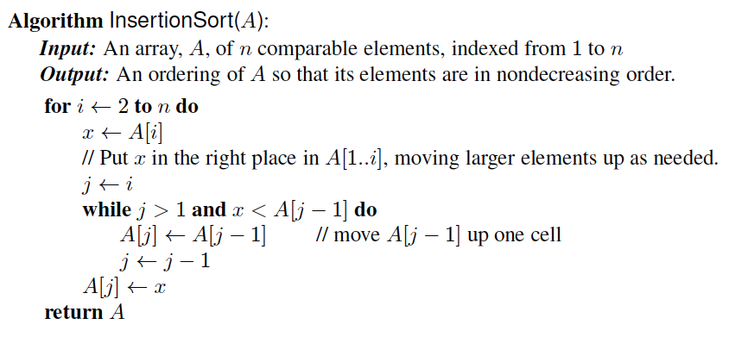
In-Place Insertion-Sort
Pseudo-code:

